Slide 1

Darwini Project
CREATION OF a darwinian combat robot
Romain BOIZUMAULT- Alexis BUSSENEAU - Luc GEFFRAULT - Vianney MATHIEU - Guillaume VAILLAND Tutor : Christian RAYMOND

Slide 2

Introduction : Main Goal
Create an artificial intelligence for a fighting bot
Create decision algorithms to defeat other robots
Bot should be able to take decision on its own
Find the best robot ever

Slide 3
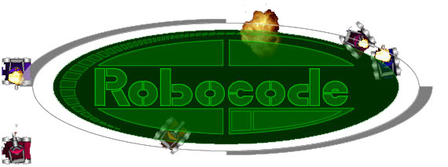
Build the best, destroy the rest !

Slide 4
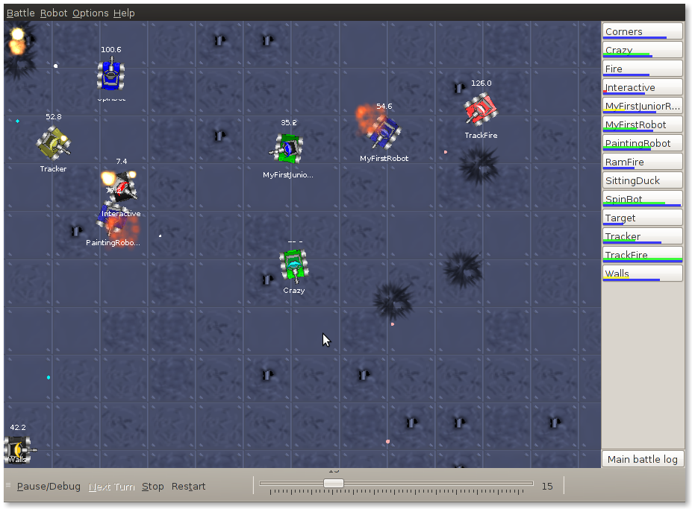
What is Robocode ?
1. Robocode
3. Parameters’ Setting
2. Classifier
A Java software
A game to teach programmation
A robot fighting simulator

Slide 5

Game’s Progress
1. Robocode
3. Parameters’ Setting
2. Classifier
Each robot has an energy bar :
Robot loses energy when shooting
Robot loses energy when hit
Robot loses energy when colliding
Robot recovers energy when it hits an enemy

Slide 6
Game’s Progress
1. Robocode
3. Parameters’ Setting
2. Classifier
Your strategy
Opponent strategy
Avoiding
Avoiding
Moving
Decision
Decision
Moving
Stopping
Stopping
Shooting
Combat
Shooting
One turn

Slide 7




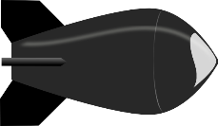
Strategy is rules
1. Robocode
3. Parameters’ Setting
2. Classifier
Automatical way
Manual rules
Solution : Generate rules in an automatical way
FIRE MY CAPTAIN !
Problem : are the rules optimal ?

Slide 8
Classifier

Slide 9

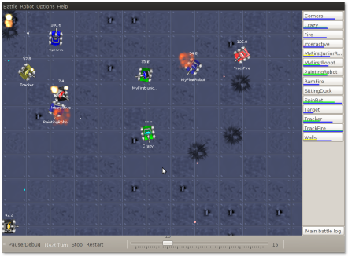
Its place
1. Robocode
3. Parameters’ Setting
2. Classifier
Darwini
Manual rules
Classifier
Decision
Each turn
New action
Environment data

Slide 10
Environment data
1. Robocode
3. Parameters’ Setting
2. Classifier
Our robot
Opponent robot
Our energy
Opponent’s
direction
Distance between the robots
Orientation of our turret
Opponent’s velocity
Our velocity

Slide 11

Concept
1. Robocode
3. Parameters’ Setting
2. Classifier
Environment data
Decision
Distance
My energy
My Velocity
…
Opponent’s Velocity
Classifier

Slide 12
Classifier = Multilayer Perceptron
1. Robocode
3. Parameters’ Setting
2. Classifier
Darwini
Classifier
(Multilayer Perceptron)
Decision
Each turn
New action
Environment data

Slide 13


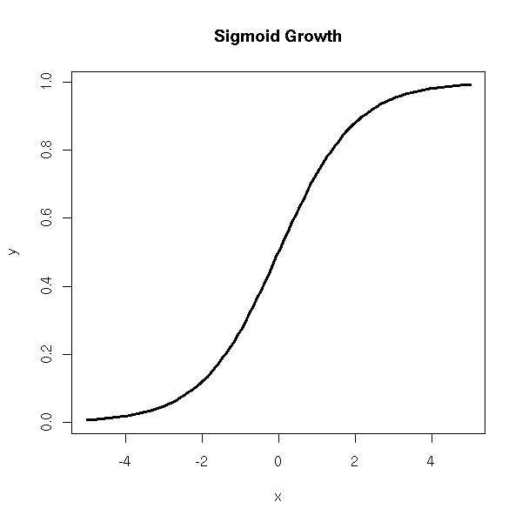
Multilayer Perceptron
1. Robocode
3. Parameters’ Setting
2. Classifier
Input layer
Hidden layer
Output layer
P_{1,1}
Distance
P_{1,2}
Hidden n°1
Input n°1
P_{1,3}
P_{1,4}
P_{2,1}
P_{2,2}
Hidden n°2
]-1, 1[
My Velocity
P_{2,3}
Hidden n°3
Decision
Shot or not shot ?
Input n°2
P_{2,4}
Hidden n°4

Slide 14

Multilayer Perceptron
1. Robocode
3. Parameters’ Setting
2. Classifier
Classifier
Parameters
Data
Which parameters ?

Slide 15

Parameters’ Setting

Slide 16
Learning from samples
1. Robocode
3. Parameters’ Setting
2. Classifier
Error-back-propagation Algorithm
Acquisition bot
Darwini’s Classifier
Data
Collecting
Observations/Examples
Create parameters

Slide 17
Data collected
1. Robocode
3. Parameters’ Setting
2. Classifier
Action « Fire »
Distance | My Energy | … | My Velocity | Success
18 | 1 | ... | 1 | False
2 | 0.5 | … | 1 | True
19 | 0.6 | … | 0.2 | False
9 | 0.2 | … | 1 | True
3 | 1 | … | 0.8 | True
… | … | … | … | …
Ponderation weights (Matrix)

Slide 18
Problem : Hard to collect every data
1. Robocode
3. Parameters’ Setting
2. Classifier
Action « Turn »
« Is it better to turn left or to turn right ? »
Impossible to collect classic samples

Slide 19
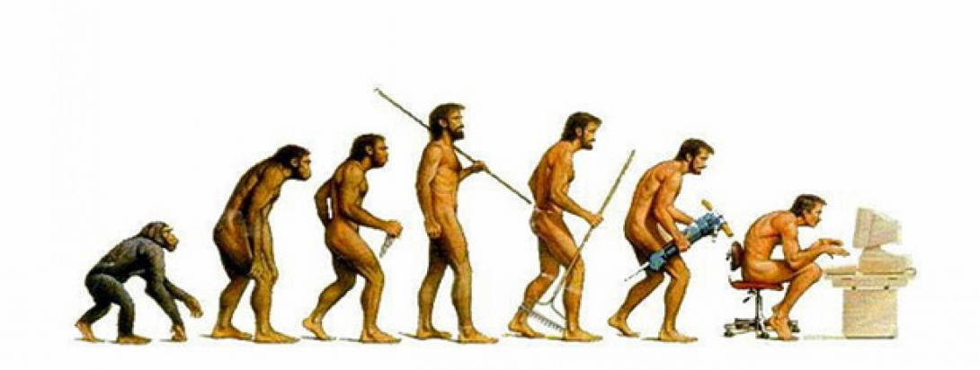
Solution : Learning from simulation
1. Robocode
3. Parameters’ Setting
2. Classifier
A new automatically way to create rules based on Darwin’s idea

Slide 20
Genetic Algorithm (Learning from simulations)
1. Robocode
3. Parameters’ Setting
2. Classifier
Random parameters’ generation (Matrix)
Random selection
Mother
Father
1 | 1 | 1 | 1 | 1 | 1 | 1 | 1
0 | 0 | 0 | 0 | 0 | 0 | 0 | 0
1 | 1 | 1 | 1 | 1 | 1 | 1 | 1
0 | 0 | 0 | 0 | 0 | 0 | 0 | 0
0 | 1 | 0 | 1 | 0 | 1 | 0 | 1
Crossover
1 | 1 | 1 | 1 | 1 | 1 | 1 | 1
Probability : 50%
0 | 0 | 0 | 0 | 0 | 0 | 0 | 0
0 | 1 | 0 | 1 | 0 | 0 | 1 | 1
Selection of best
1 | 0 | 1 | 0 | 1 | 1 | 0 | 0
0 | 1 | 0 | 1 | 0 | 0 | 1 | 1
Population
Child n°1
Child n°2
Parents
Children
Mutation
Terminaison
1 | 1 | 1 | 1 | 1 | 1 | 1 | 1
1 | 0 | 1 | 0 | 1 | 1 | 0 | 0
1 | 0 | 1 | 0 | 1 | 1 | 0 | 0
0 | 1 | 0 | 0 | 0 | 0 | 1 | 1
Probability : 0,1%
0 | 0 | 0 | 0 | 0 | 0 | 0 | 0
0 | 1 | 0 | 1 | 0 | 0 | 1 | 1

Slide 21
Genetic Algorithm (Learning from simulations)
1. Robocode
3. Parameters’ Setting
2. Classifier
Random parameters’ generation (Matrix)
Final energy ?
Winner ?
Precision ?
Damage ?
Score ?
A lot of questions in order to select best individuals
0 | 1 | 0 | 1 | 0 | 1 | 0 | 1
1 | 1 | 1 | 1 | 1 | 1 | 1 | 1
0 | 0 | 0 | 0 | 0 | 0 | 0 | 0
0 | 1 | 0 | 1 | 0 | 0 | 1 | 1
Selection of best
Population
Parents
Children
1 | 1 | 1 | 1 | 1 | 1 | 1 | 1
1 | 0 | 1 | 0 | 1 | 1 | 0 | 0
0 | 0 | 0 | 0 | 0 | 0 | 0 | 0
0 | 1 | 0 | 1 | 0 | 0 | 1 | 1
8 janvier 2015

Slide 22
Comparison of the different algorithms
1. Robocode
3. Parameters’ Setting
2. Classifier
Is it possible to set the classifier parameters ?
Action | Learning from simulations Genetic algorithm | Learning from samples Error-back-propagation algorithm
Shoot | Yes | Yes
Not shoot | Yes | Yes
Rotate the turret | Yes | No
Move the tank | Yes | No

Slide 23
Conclusion
DONE
Chose of entrance data
Created an Acquisition bot
Implemented the perceptron
Began to test it with the action « shoot »
TO DO
Create the genetic algorithm
Choose the selection’s criteria
Execute and test thousands of time
Find the best robot

Slide 24

Prototype

Slide 25

Question time

